Slide 1
Formal Reasoning on Neural Networks
Faezeh Labbaf*, Martin Blicha*, Michael Wand#, Tomas Kolarik*, Natasha Sharygina*
* Università della Svizzera italiana (University of Lugano, USI)
# The Swiss AI Lab IDSIA USI-SUPSI

Slide 2
Reasoning on neural networks
Introduction
Neural networks are used everywhere.
Complicated and unknown
Behave unexpectedly
Can we really trust NNs?
Our goal: Explaining the neural network reasoning
Input (x₁ …, x_{d})
output
Faezeh Labbaf
Formal reasoning of NNs
AVM 2024

Slide 3
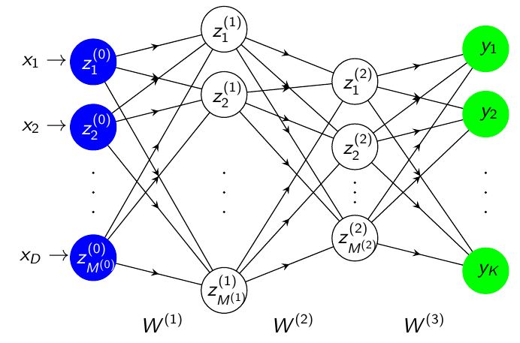
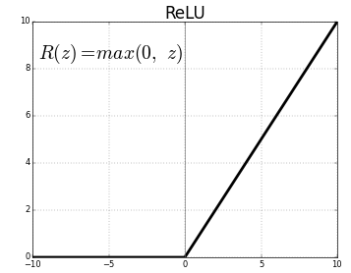
Neural Networks
Introduction
A feedforward neural network can be described as a set of neurons, organized in layers
Each neuron computes a weighted sum over its inputs, followed by a nonlinearity
The connection weights are learned using gradient descent
The State-of-the-art ReLU nonlinearity
A prototypical neural network
Faezeh Labbaf
Formal reasoning of NNs
AVM 2024
Notes:
Here we have a diagram of a neural net for a k-class classification task. The network has several layers and several neurons in each layer. The output of each neuron is the weighted sum of it’s input followed by a non-linearity. A commonly used non-lineary is ReLU function, which is a piece-wise linear function. The output is zero for negative inputs and the same input otherwise.

Slide 4
Example: Image Classification
Introduction
We work with classification networks
MNIST Corpus: Classify handwritten digits
D = 28 x 28 = 784, K = 10, input 0.0 … 1.0
0
1
9
Faezeh Labbaf
Formal reasoning of NNs
AVM 2024

Slide 5
Explaination on neural networks.
Introduction
What is an explanation?
Visualization/classical explanation
Logic based explanation
Lots of works by AI community
Some works by formal methods community
Our work
Faezeh Labbaf
Formal reasoning of NNs
AVM 2024
Notes:
TODO: this slide is ugly :(

Slide 6
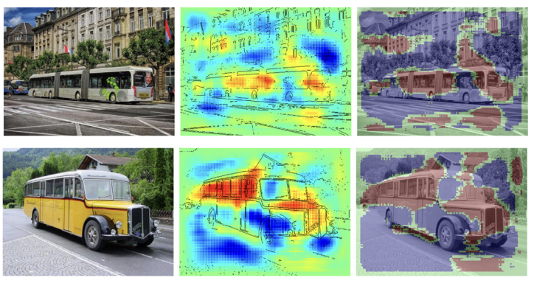
Classical methods for reasoning
Explanation methods
“Understand the contribution of a single pixel of an image x to the prediction f(x) made by a classifier f in an image classification task"
Bach et al: On Pixel-Wise Explanations for Non-Linear Classifier Decisions by Layer-Wise Relevance Propagation. PLOS One, 2015.
Incomplete
Works for a single sample, not the entire domain
Faezeh Labbaf
Formal reasoning of NNs
AVM 2024
Notes:
:: For every bud image I examined, the shape of windows were important for the classifier. But what about those you didn’t examined?

Slide 7
Classical methods for reasoning
Explanation methods
Class Model Visualisation
Numerically computed images
Pick a class and do the computations backward
Mostly visualization
Not formal
Still probabilistic, no guarantee
Simonyan et al., Deep Inside Convolutional Networks: Visualising Image Classification Models and Saliency Maps. ICLR Workshop Proceedings, 2014
Faezeh Labbaf
Formal reasoning of NNs
AVM 2024

Slide 8
Formal Explanation definition
Explanation methods
“An explanation is a minimal subset of pixels of a given input image that is sufficient for the DNN to classify the image, [...]"
Sun et al., Explaining Image Classifiers Using Statistical Fault Localization, ECCV 2020
An explanation is a subset of input features (e.g., pixels) of a given sample such that perturbing any other input features cannot change the classification.
Logic-based explanations
Ignatiev et al., Abduction-Based Explanations for Machine Learning Models, AAAI 2019
seven
two
seven
empirical approach
formal approach
Faezeh Labbaf
Formal reasoning of NNs
AVM 2024
Notes:
Logic based: thats what we are working on!

Slide 9
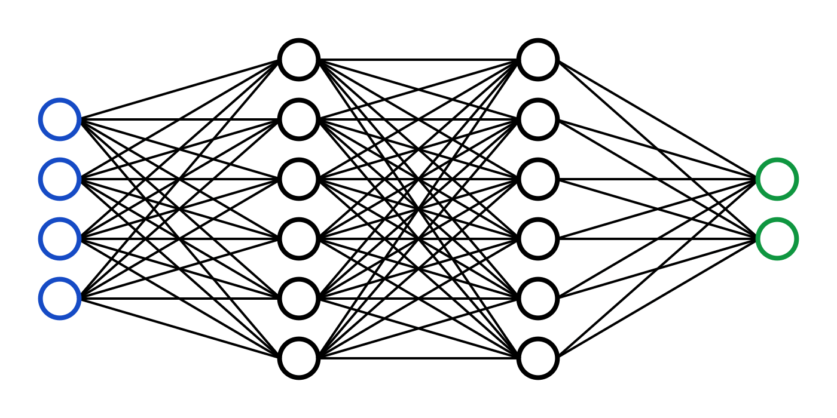
State of the Art
Verification of NNs
Formal Verification of Neural Networks
[1] Marabou
[2] 𝛼ꞵ-crown
✔
(+ Proof)
Constraint solver
❌
(+ Counterexample)
Property
(input output relations)
“If cholesterol is high and blood pressure is low then there is a high risk of heart attack.”
[1] Wu et al., Marabou 2.0: A Versatile Formal Analyzer of Neural Networks, CAV2024
[2] Xu et al., Fast and Complete: Enabling Complete Neural Network Verification with Rapid and Massively Parallel Incomplete Verifiers, ICLR2021
Faezeh Labbaf
Formal reasoning of NNs
AVM 2024
Notes:
Medical Domain!

Slide 10
Computing Explanations with NN Verifiers
Explanations using verification
Input: fixed sample
for f in sample features{
free f;
Query input/output property;
if classification changes:
fix f;
else: keep it free;}
Return set of fixed features;
Classifies input features as relevant vs irrelevant
Computes subset-minimal explanation
Constraint solver
Explanation
Classification CAN/CANNOT change
Input sample
Classification property + input restrictions
Faezeh Labbaf
Formal reasoning of NNs
AVM 2024
Notes:
Input constraints can be just inputs domain, or actual constraints like age bigger than 60

Slide 11
Computing Explanations with NN Verifiers
Explanations using verification
Input: fixed sample
for f in sample features{
free f;
Query input/output property;
if classification changes:
fix f;
else: keep it free;}
Return set of fixed features;
Classifies input features as relevant vs irrelevant
Computes subset-minimal explanation
Constraint solver
Explanation
Classification CAN/CANNOT change
3
Input sample
1
Classification property + input restrictions
0
9
Faezeh Labbaf
Formal reasoning of NNs
AVM 2024
Notes:
Input constraints can be just inputs domain, or actual constraints like age bigger than 60

Slide 12
Computing Explanations with NN Verifiers
Explanations using verification
Input: fixed sample
for f in sample features{
free f;
Query input/output property;
if classification changes:
fix f;
else: keep it free;}
Return set of fixed features;
Classifies input features as relevant vs irrelevant
Computes subset-minimal explanation
Constraint solver
Explanation
Classification CAN/CANNOT change
-
Input sample
1
Classification property + input restrictions
0
9
Faezeh Labbaf
Formal reasoning of NNs
AVM 2024
Notes:
Input constraints can be just inputs domain, or actual constraints like age bigger than 60

Slide 13
Computing Explanations with NN Verifiers
Explanations using verification
Input: fixed sample
for f in sample features{
free f;
Query input/output property;
if classification changes:
fix f;
else: keep it free;}
Return set of fixed features;
Classifies input features as relevant vs irrelevant
Computes subset-minimal explanation
Constraint solver
Explanation
Classification CAN/CANNOT change
-
Input sample
1
Classification property + input restrictions
0
9
Faezeh Labbaf
Formal reasoning of NNs
AVM 2024
Notes:
Input constraints can be just inputs domain, or actual constraints like age bigger than 60

Slide 14
Computing Explanations with NN Verifiers
Explanations using verification
Input: fixed sample
for f in sample features{
free f;
Query input/output property;
if classification changes:
fix f;
else: keep it free;}
Return set of fixed features;
Classifies input features as relevant vs irrelevant
Computes subset-minimal explanation
Constraint solver
Explanation
Classification CAN/CANNOT change
3
Input sample
1
Classification property + input restrictions
0
9
Faezeh Labbaf
Formal reasoning of NNs
AVM 2024
Notes:
Input constraints can be just inputs domain, or actual constraints like age bigger than 60

Slide 15
Computing Explanations with NN Verifiers
Explanations using verification
Input: fixed sample
for f in sample features{
free f;
Query input/output property;
if classification changes:
fix f;
else: keep it free;}
Return set of fixed features;
Classifies input features as relevant vs irrelevant
Computes subset-minimal explanation
Constraint solver
Explanation
Classification CAN/CANNOT change
3
Input sample
-
Classification property + input restrictions
0
9
Faezeh Labbaf
Formal reasoning of NNs
AVM 2024
Notes:
Input constraints can be just inputs domain, or actual constraints like age bigger than 60

Slide 16
Computing Explanations with NN Verifiers
Explanations using verification
Input: fixed sample
for f in sample features{
free f;
Query input/output property;
if classification changes:
fix f;
else: keep it free;}
Return set of fixed features;
Classifies input features as relevant vs irrelevant
Computes subset-minimal explanation
Constraint solver
Explanation
Classification CAN/CANNOT change
3
Input sample
-
Classification property + input restrictions
0
9
Faezeh Labbaf
Formal reasoning of NNs
AVM 2024
Notes:
Input constraints can be just inputs domain, or actual constraints like age bigger than 60

Slide 17
Computing Explanations with NN Verifiers
Explanations using verification
Input: fixed sample
for f in sample features{
free f;
Query input/output property;
if classification changes:
fix f;
else: keep it free;}
Return set of fixed features;
Classifies input features as relevant vs irrelevant
Computes subset-minimal explanation
Constraint solver
Explanation
Classification CAN/CANNOT change
3
Input sample
-
Classification property + input restrictions
0
9
Faezeh Labbaf
Formal reasoning of NNs
AVM 2024
Notes:
Input constraints can be just inputs domain, or actual constraints like age bigger than 60

Slide 18
Computing Explanations with NN Verifiers
Explanations using verification
Input: fixed sample
for f in sample features{
free f;
Query input/output property;
if classification changes:
fix f;
else: keep it free;}
Return set of fixed features;
Classifies input features as relevant vs irrelevant
Computes subset-minimal explanation
Constraint solver
Explanation
Classification CAN/CANNOT change
3
Input sample
-
Classification property + input restrictions
-
9
Faezeh Labbaf
Formal reasoning of NNs
AVM 2024
Notes:
Input constraints can be just inputs domain, or actual constraints like age bigger than 60

Slide 19
Computing Explanations with NN Verifiers
Explanations using verification
Input: fixed sample
for f in sample features{
free f;
Query input/output property;
if classification changes:
fix f;
else: keep it free;}
Return set of fixed features;
Classifies input features as relevant vs irrelevant
Computes subset-minimal explanation
Constraint solver
Explanation
Classification CAN/CANNOT change
3
Input sample
-
Classification property + input restrictions
-
9
Faezeh Labbaf
Formal reasoning of NNs
AVM 2024
Notes:
Input constraints can be just inputs domain, or actual constraints like age bigger than 60

Slide 20
Computing Explanations with NN Verifiers
Explanations using verification
Input: fixed sample
for f in sample features{
free f;
Query input/output property;
if classification changes:
fix f;
else: keep it free;}
Return set of fixed features;
Classifies input features as relevant vs irrelevant
Computes subset-minimal explanation
Constraint solver
Explanation
Classification CAN/CANNOT change
3
Input sample
-
Classification property + input restrictions
-
-
Faezeh Labbaf
Formal reasoning of NNs
AVM 2024
Notes:
Input constraints can be just inputs domain, or actual constraints like age bigger than 60

Slide 21
Computing Explanations with NN Verifiers
Explanations using verification
Input: fixed sample
for f in sample features{
free f;
Query input/output property;
if classification changes:
fix f;
else: keep it free;}
Return set of fixed features;
Classifies input features as relevant vs irrelevant
Computes subset-minimal explanation
Constraint solver
Explanation
Classification CAN/CANNOT change
3
Input sample
-
Classification property + input restrictions
-
9
Faezeh Labbaf
Formal reasoning of NNs
AVM 2024
Notes:
Input constraints can be just inputs domain, or actual constraints like age bigger than 60

Slide 22
Computing Explanations with NN Verifiers
Explanations using verification
Input: fixed sample
for f in sample features{
free f;
Query input/output property;
if classification changes:
fix f;
else: keep it free;}
Return set of fixed features;
Classifies input features as relevant vs irrelevant
Computes subset-minimal explanation
3
Constraint solver
Classification CAN/CANNOT change
-
3
-
Input sample
-
Classification property + input restrictions
9
-
9
Faezeh Labbaf
Formal reasoning of NNs
AVM 2024
Notes:
Input constraints can be just inputs domain, or actual constraints like age bigger than 60

Slide 23
Computing Explanations with NN Verifiers
Explanations using verification
Computationally intensive: one verification query per input feature
Explanations are input specific
Classification CAN/CANNOT change
Explanation
Constraint solver
Input sample
Classification property + input restrictions
Faezeh Labbaf
Formal reasoning of NNs
AVM 2024
Notes:
Input constraints can be just inputs domain, or actual constraints like age bigger than 60

Slide 24
Our solution
Explanations using verification
Computationally intensive
Input specific explanation
Avoid unnecessary queries
Generalized explanations
Constraint solver
Classification CAN/CANNOT change
Explanation
Classification property + input restrictions
OpenSMT
Input sample
Faezeh Labbaf
Formal reasoning of NNs
AVM 2024

Slide 25
Conclusion
What is an NN explanation?
Classical methods of NN explanation
Logic based NN explanation
Using safety properties to explain
We have some cool ideas, expect us the results soon!
Thank you for listening.
Any questions?
Faezeh Labbaf
Formal reasoning of NNs
AVM 2024

Slide 27
Adversarial Examples
Faezeh Labbaf
Formal reasoning of NNs
AVM 2024

